Slide 1
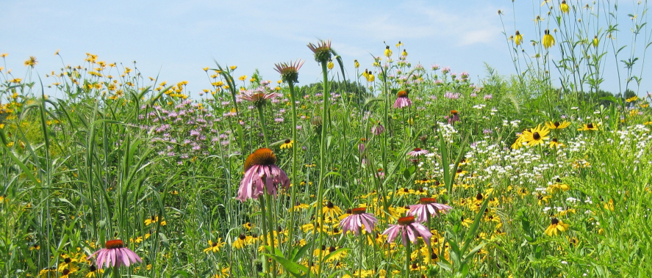
Optimize native mini-meadow germination for biodiversity CURE
Catarina Mata
Borough of Manhattan Community College

Slide 2
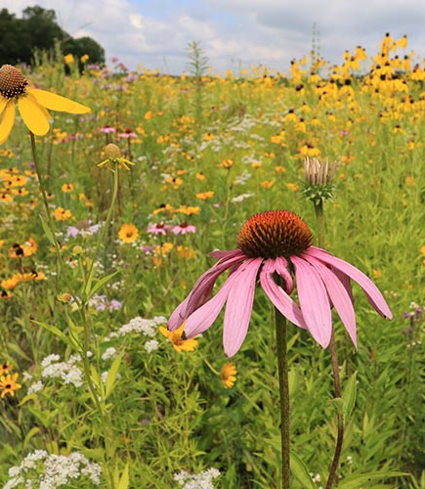
Why mini-meadows?
Habitat and food source for pollinators
Supports local wild live
Small scale re-wilding
Low effort lawn alternative
Flowers through the season if well planned
Suitable for urban and suburban gardens
Increases biodiversity

Slide 3
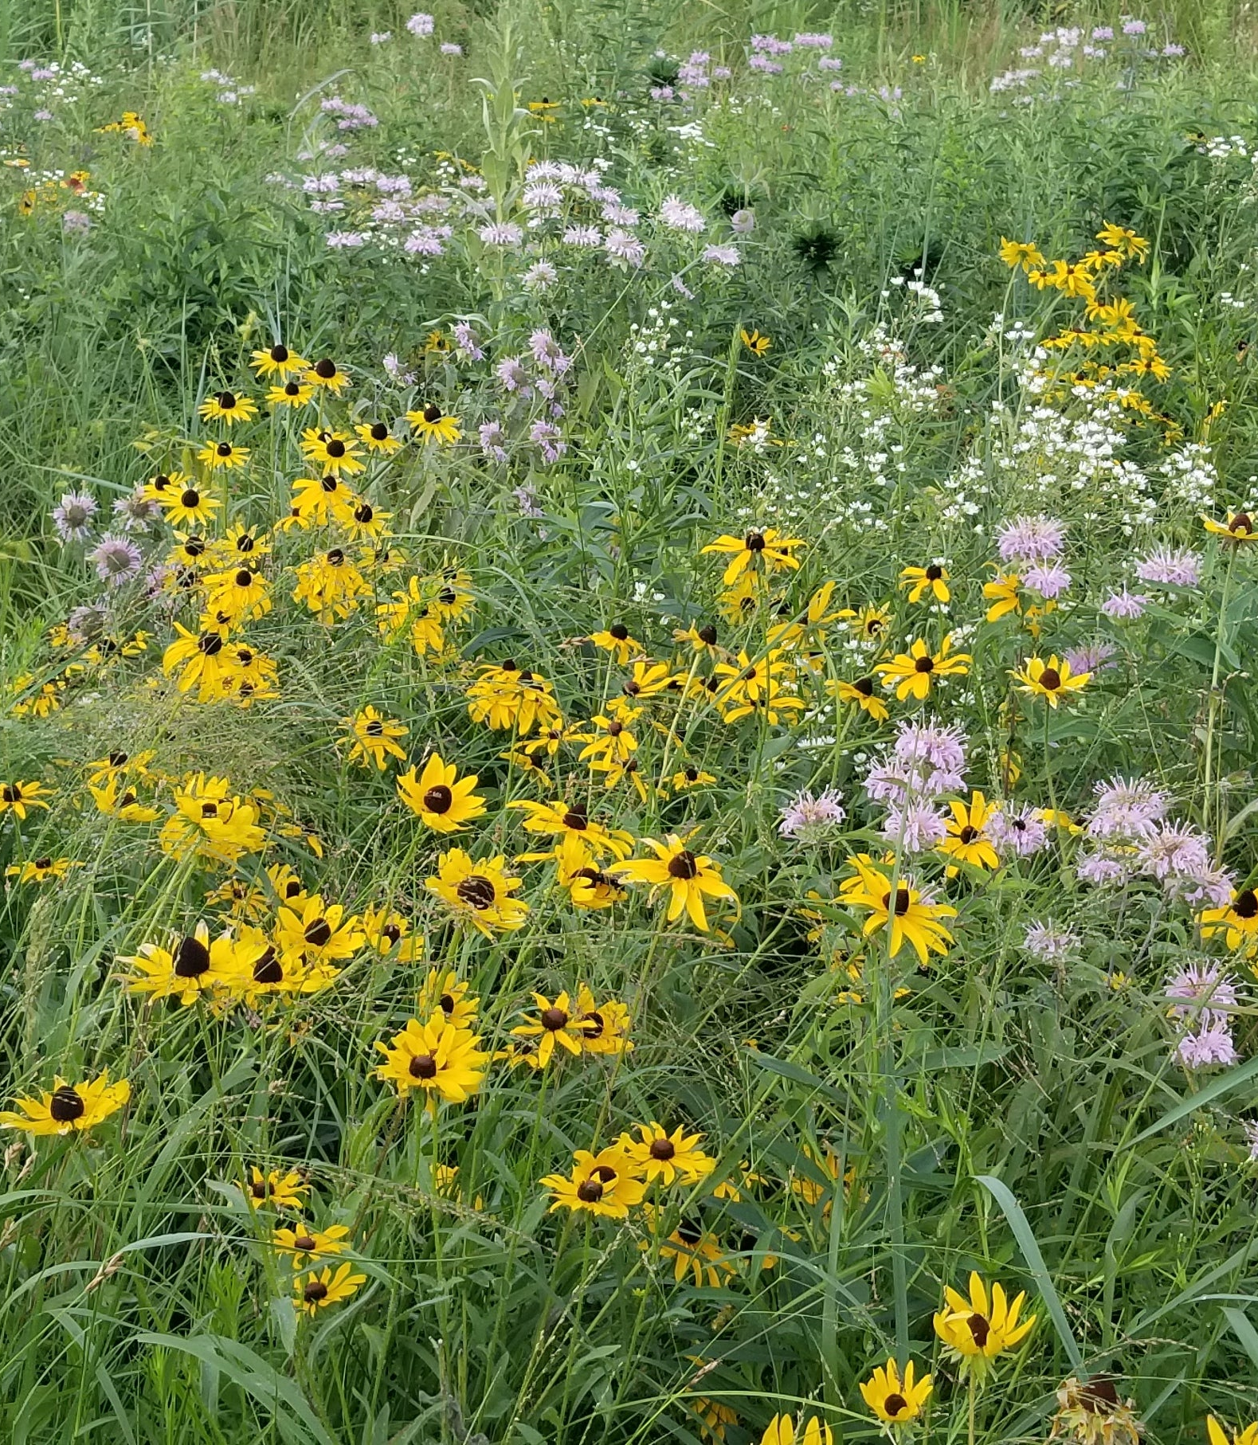
Issues starting a mini-meadow
Buying plants is expensive
Finding local native plants is not easy
Germinating from seed is cheap and libraries give native seeds for free, but…
Does not often go well, seed supply is limited, this is where your students can help!

Slide 4
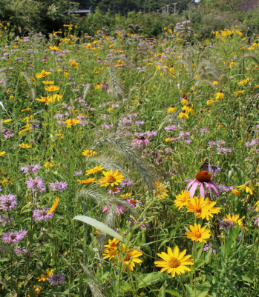
Optimize germination!
Determine what can increase germination of the native mini-meadow candidates:
Cold vernalization
Scarification physical/acid
Find what makes most species germinate fast, NO 60 days of cold.

Slide 5
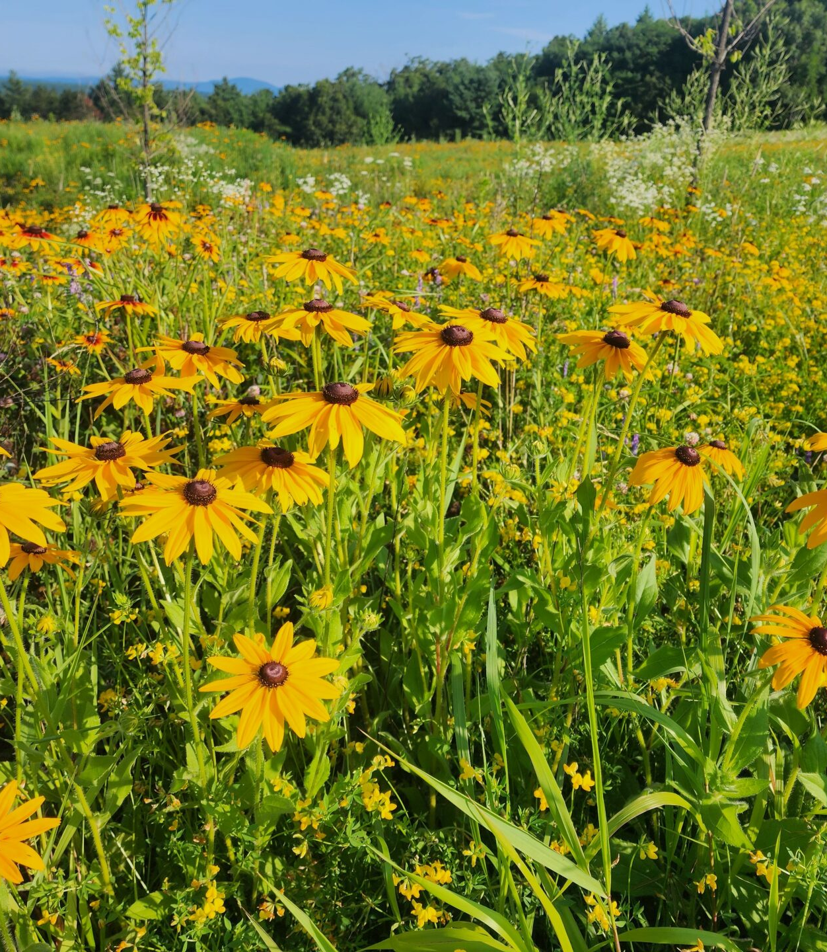
Learning Objectives
Apply the scientific method
Learn experimental design
Learn to do literature research
Practice organized data collection
Treat and present data
Learn about native flora
Disseminate findings to the local community, garden groups, libraries, local master gardeners.

Slide 6
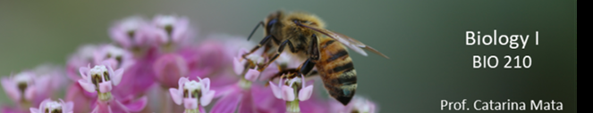
How to:
1. Divide the class into groups of 3-4 students.
2. Do in class literature research on meadow species native to the area, what is known about their germination and ecology (invite Library staff to introduce search).
3. Select one or two species per group, make sure there will be blooms throughout the season, see what seeds will be available.
4. Decide what treatment(s) to test based on the literature and ecology of the area. Ex: Acid, cold, H₂O₂ , physical scarification, fire.
5. Plan experiment in the lab, field plot or both. Check seeds weekly after treatment.
6. Analyze and discuss data.
7. Present findings as leaflet to share out of class or as a poster.

Slide 7





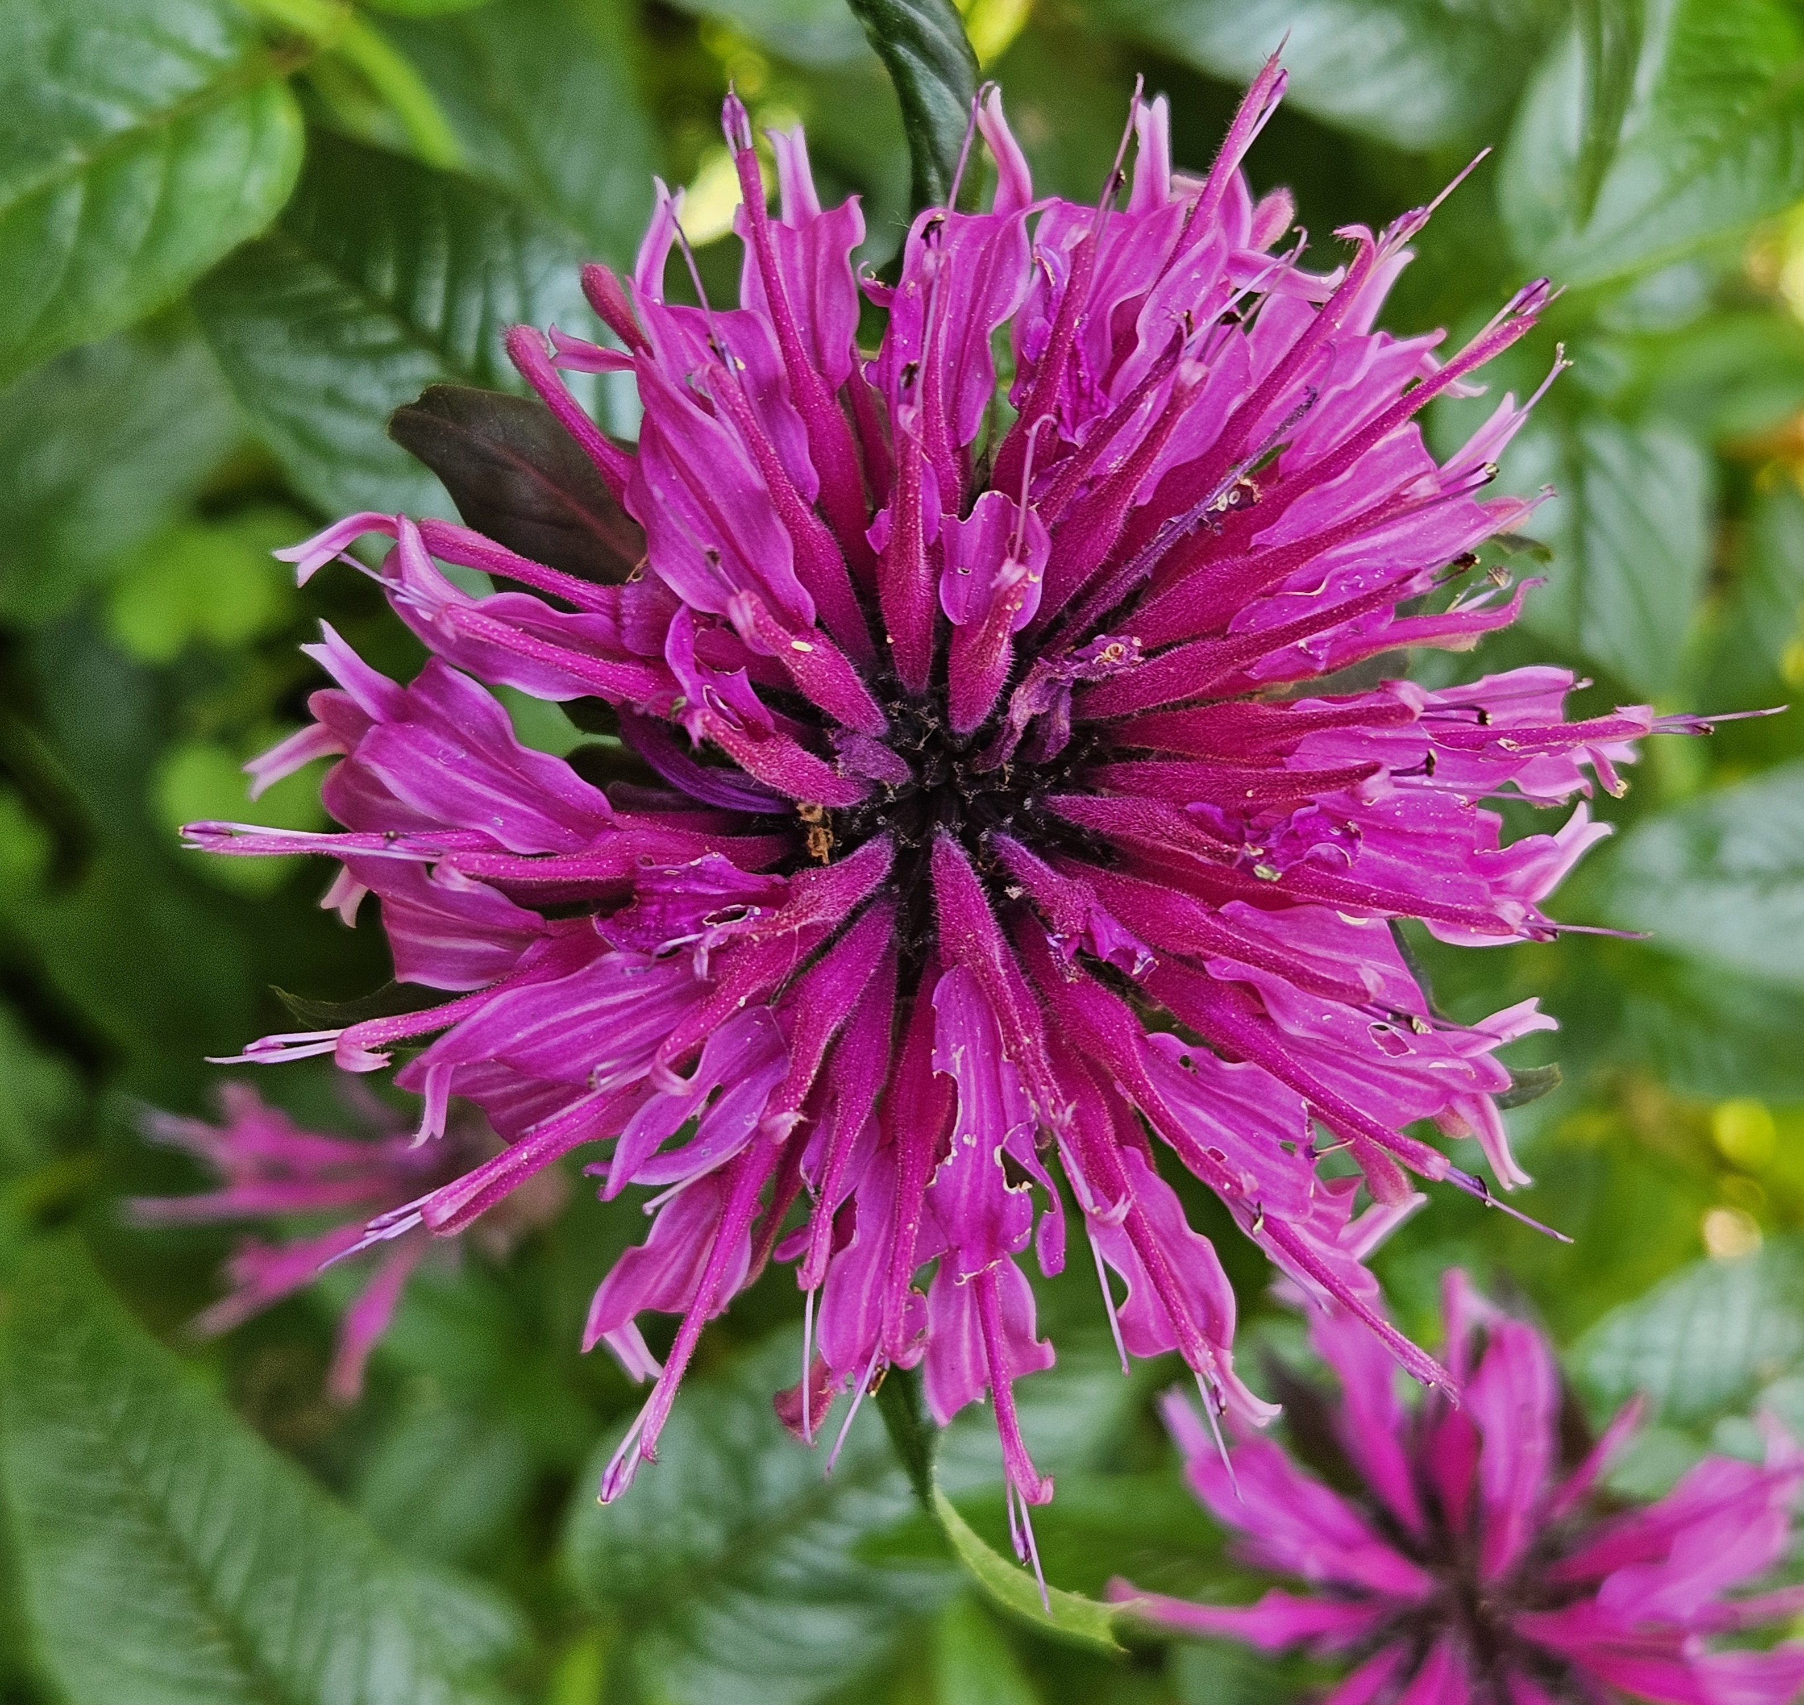
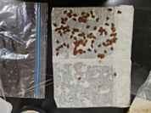
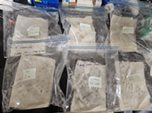
Materials and Methods
Six New York native species were selected:
Asclepias incarnata (swamp milkweed)
Asclepias tuberosa (butterfly weed)
Echinacea purpurea (cone flower)
Monarda fistulosa (wild bergamot
Symphyotrichum novae-angliae (New England aster)
Zizia aurea (golden alexander).
Six lab treatments were tested for all six species, 100 seeds of each.
vernalized for 30 days,14 days and 7 days at 4.5°C.
Treated with HCl 0.01M (pH 2) for 1hour and then rinsed with water.
3. Cold + acid for the 14 and 7 days.
All treatments and controls with no treatments were put to germinate in sealed plastic bags under lights at 25 to 30°C.

Slide 8
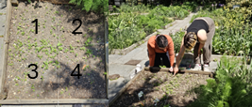
Field plot seeds before winter vs in April
Experimental plot at Washington Market Square park, downtown Manhattan (under BMCC). 200 seeds of each species were added in December to subplots 1 and 4 and in April to subplots 2 and 3.
Sadly, there were pests in action.

Slide 9
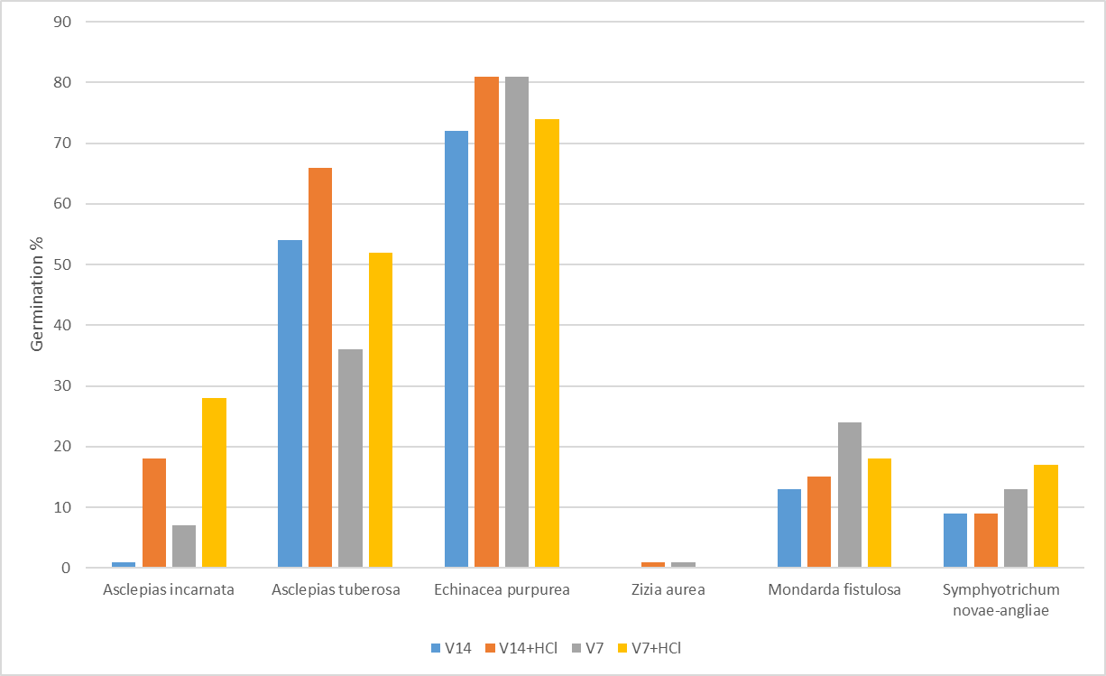
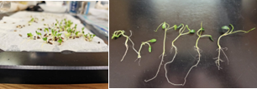
Results
Echinacea purpurea seedlings from control seeds (left) and from acid treated seeds (right ). Photos by Tosha.
Percentage of germination with HCl 0.01M acid scarification vs. no acid scarification, with and without 7 and 14 days of moist vernalization at 4.5oC, plus untreated controls. 100 seeds per treatment.

Slide 10
